Slide 1
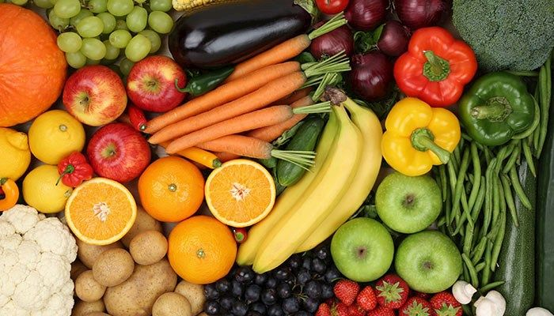
Comparison of produce price in U.S from 1999 to 2023
Dmytro Lukinchuk
Emplid:24440864
Csc 10800: Foundation of Data Science Fall 2024

Slide 2
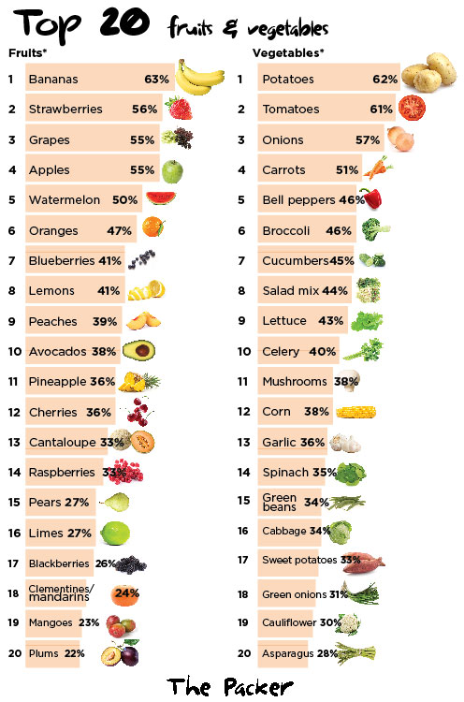
Top 20 fruits and vegetables consumed in USA in 21st century

Slide 3
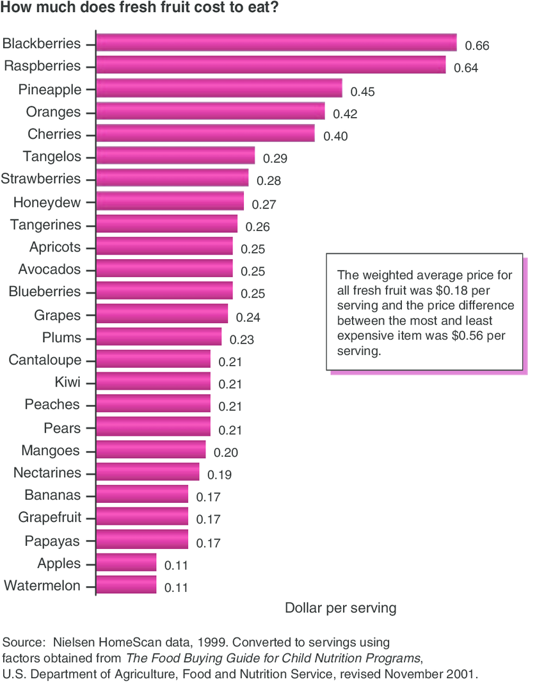
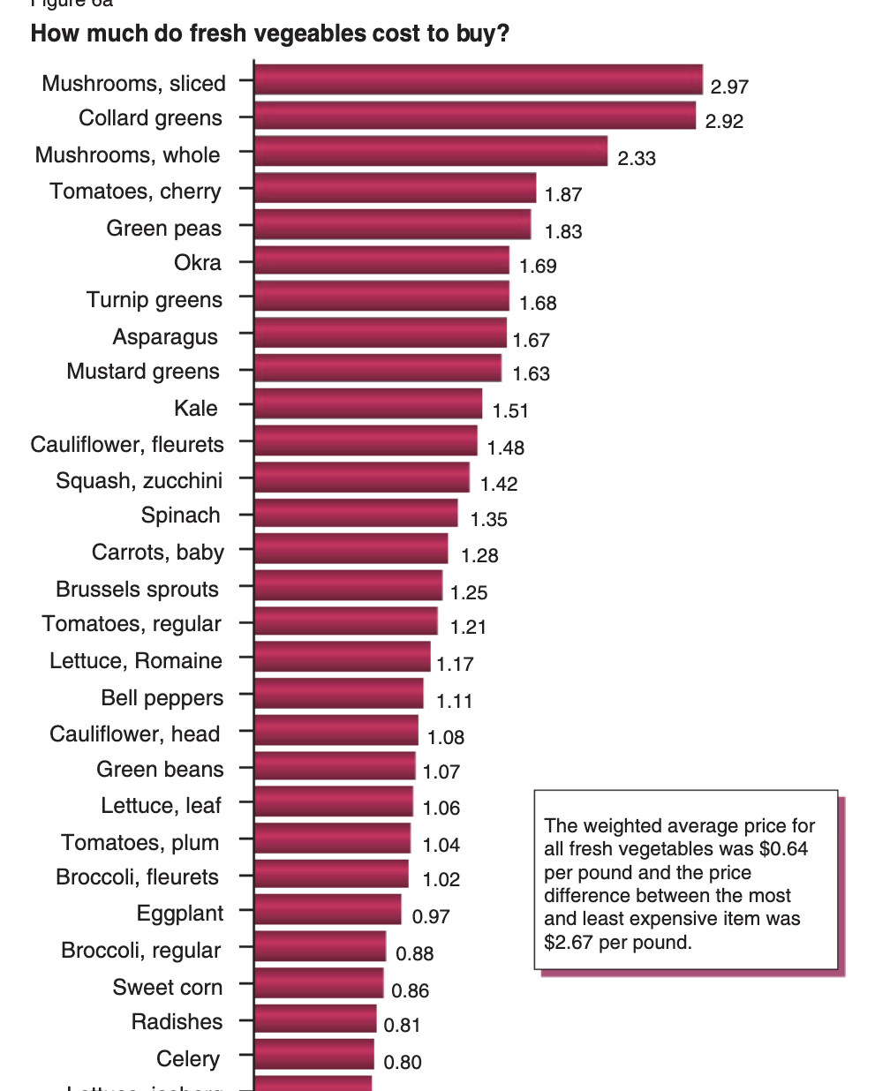
Fruits and Vegetables price in USA at the beginning of 20th century

Slide 4
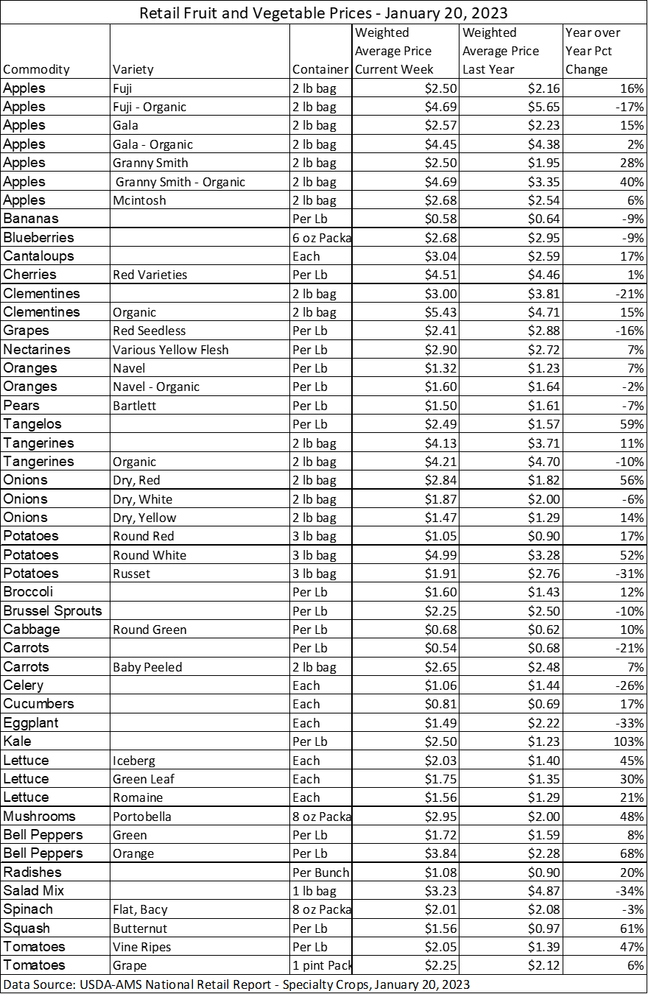
Average Fruits and Vegetables price in 2023
As we can notice, the price for fruits and vegetables has changed drastically compared to previous slide where i showed price of the same products 20 years ago. One of the main reasons are inflation and environmental change.

Slide 5
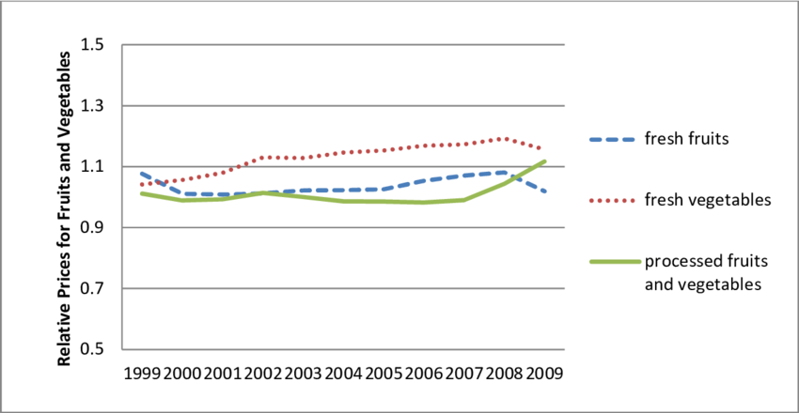
Linear graph that shows changes in price.
This graph shows the changes in price for fruits and vegetables in USA. In my next steps i have decided to collect and examine these changes through my data set.

Slide 6
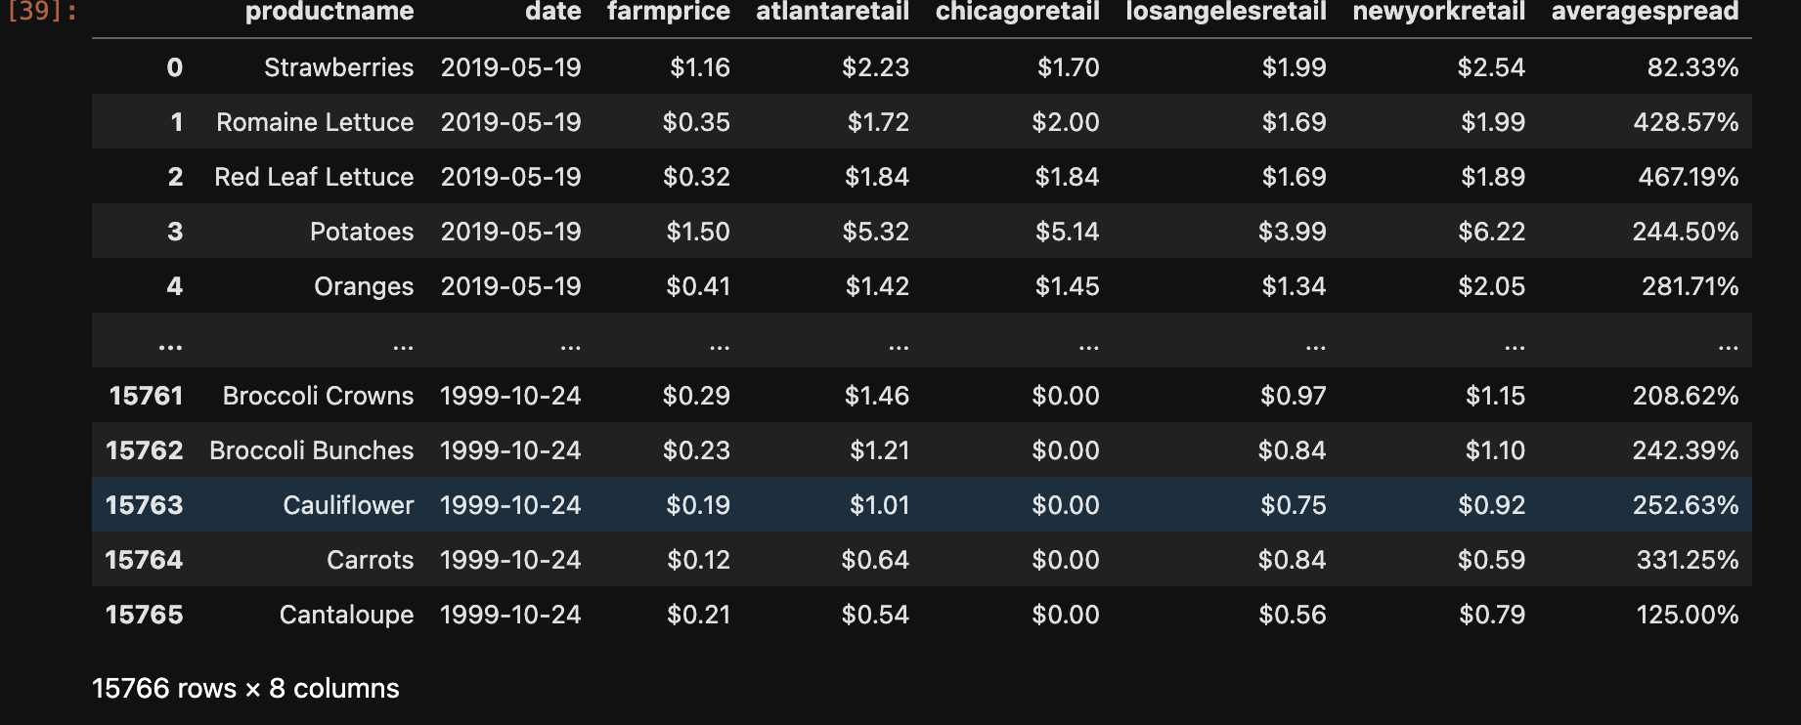
My dataset and all important information for research

Slide 7
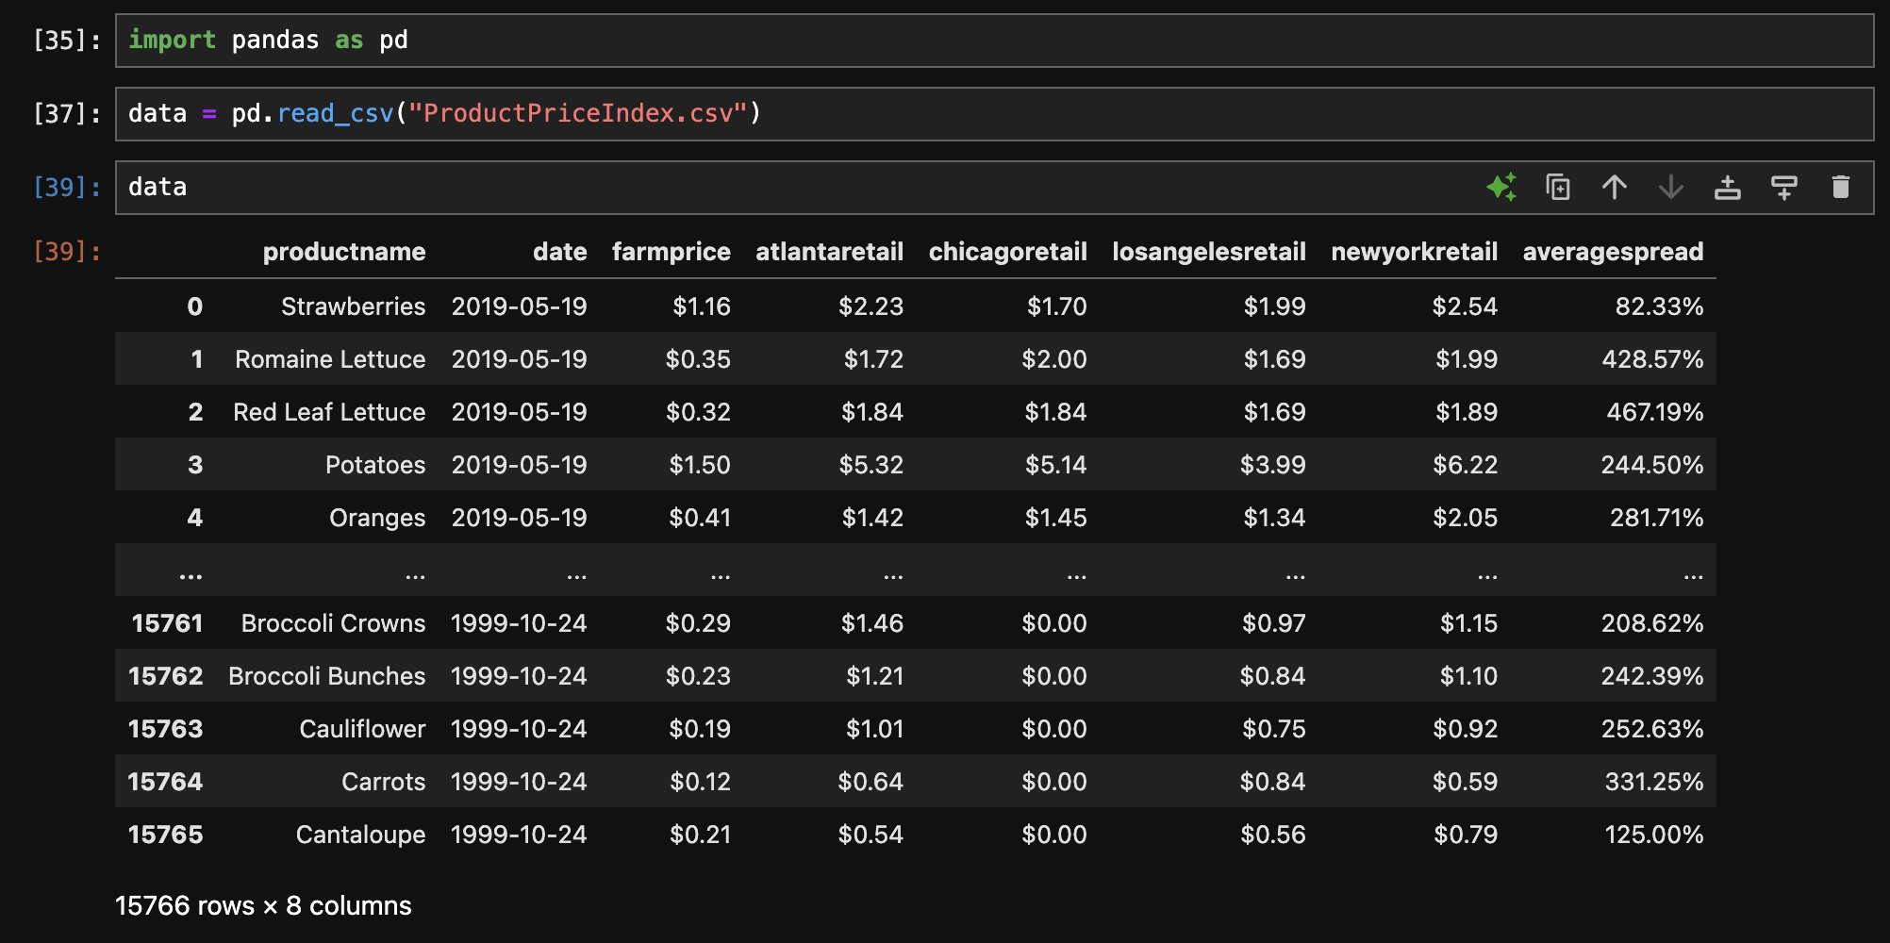

Slide 8
Column Descriptions
Productname- the name of either fruit or vegetable
Date- a specific year when the data was collected
Farmprice- how much produce was trade on farm
Averagespread- popularity of specific produce
Newyorkretail - the price for produce in New York
Atlantaretail- the price for produce in Atlanta
Chicagoretail- the price for produce in Chicago
LosAngelesretail- the price for produce in Los Angeles

Slide 9
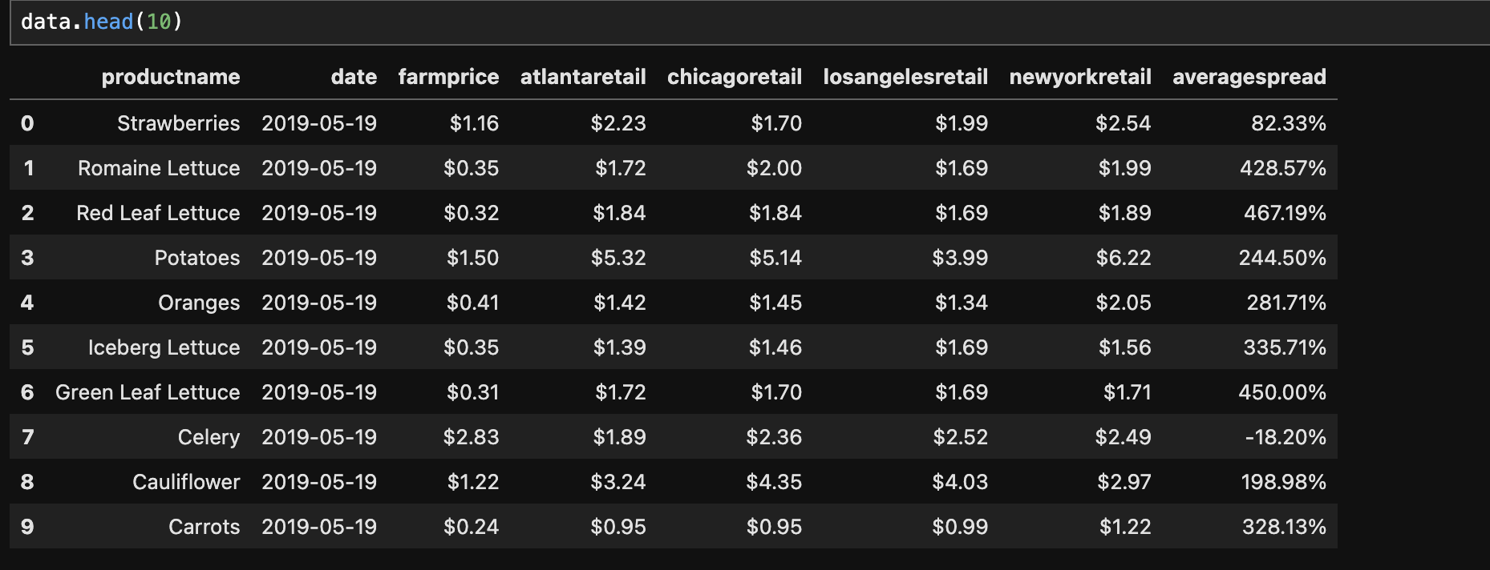
Dividing and extracting first 10 rows from my data.

Slide 10
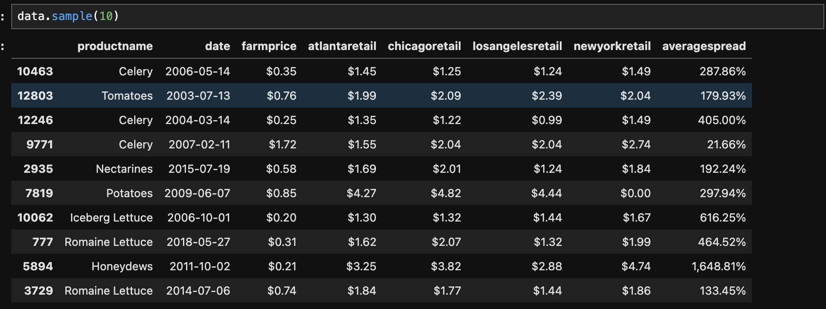
Choosing 10 random rows.

Slide 11
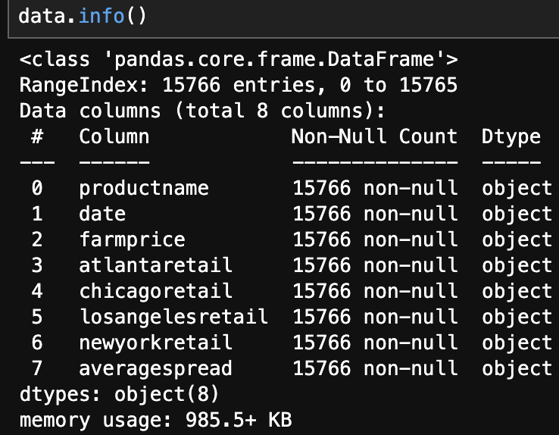
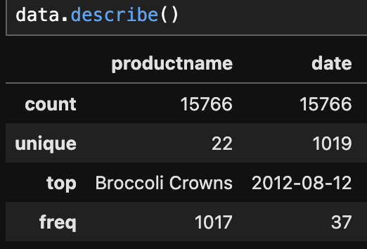
Column Information

Slide 12
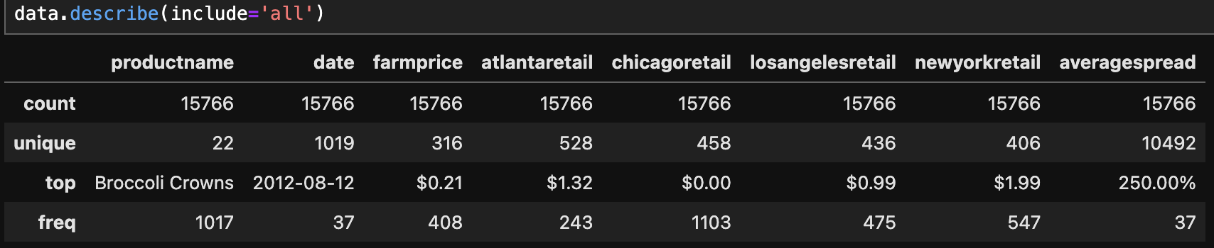
Full information

Slide 13
What did i learn so far?
1.There are 15 766 different kinds of produce and the date when price was collected.
2. There are 1 019 unique dates counted which is really wide.
3. The top selling product is Broccoli Crowns which got 250% average spread.
4. Column chicagoretail has the most frequent data.
5. The most unique data is in averagespread column which gives a diverse information.
6. Will try to see the differences in price of produce in certain cities and years.

Slide 14
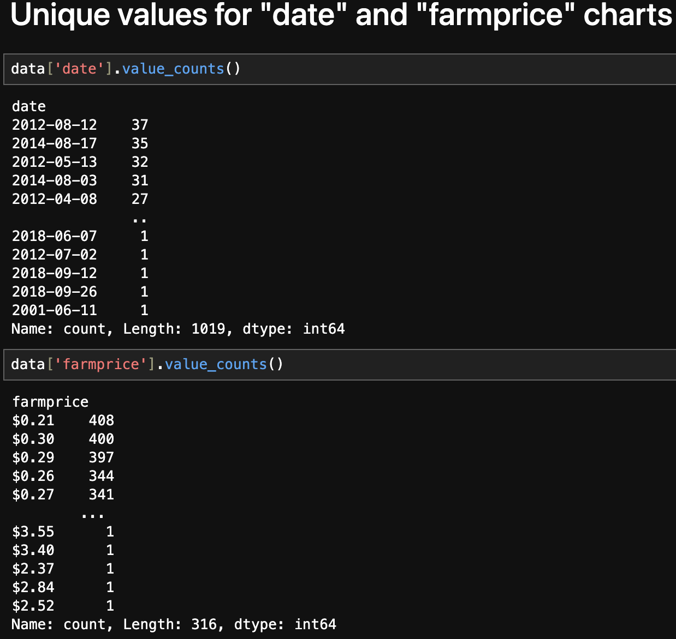

Slide 15
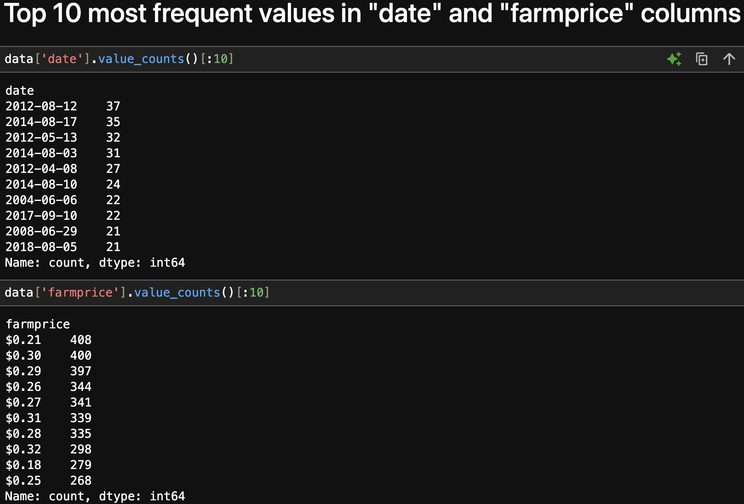

Slide 16
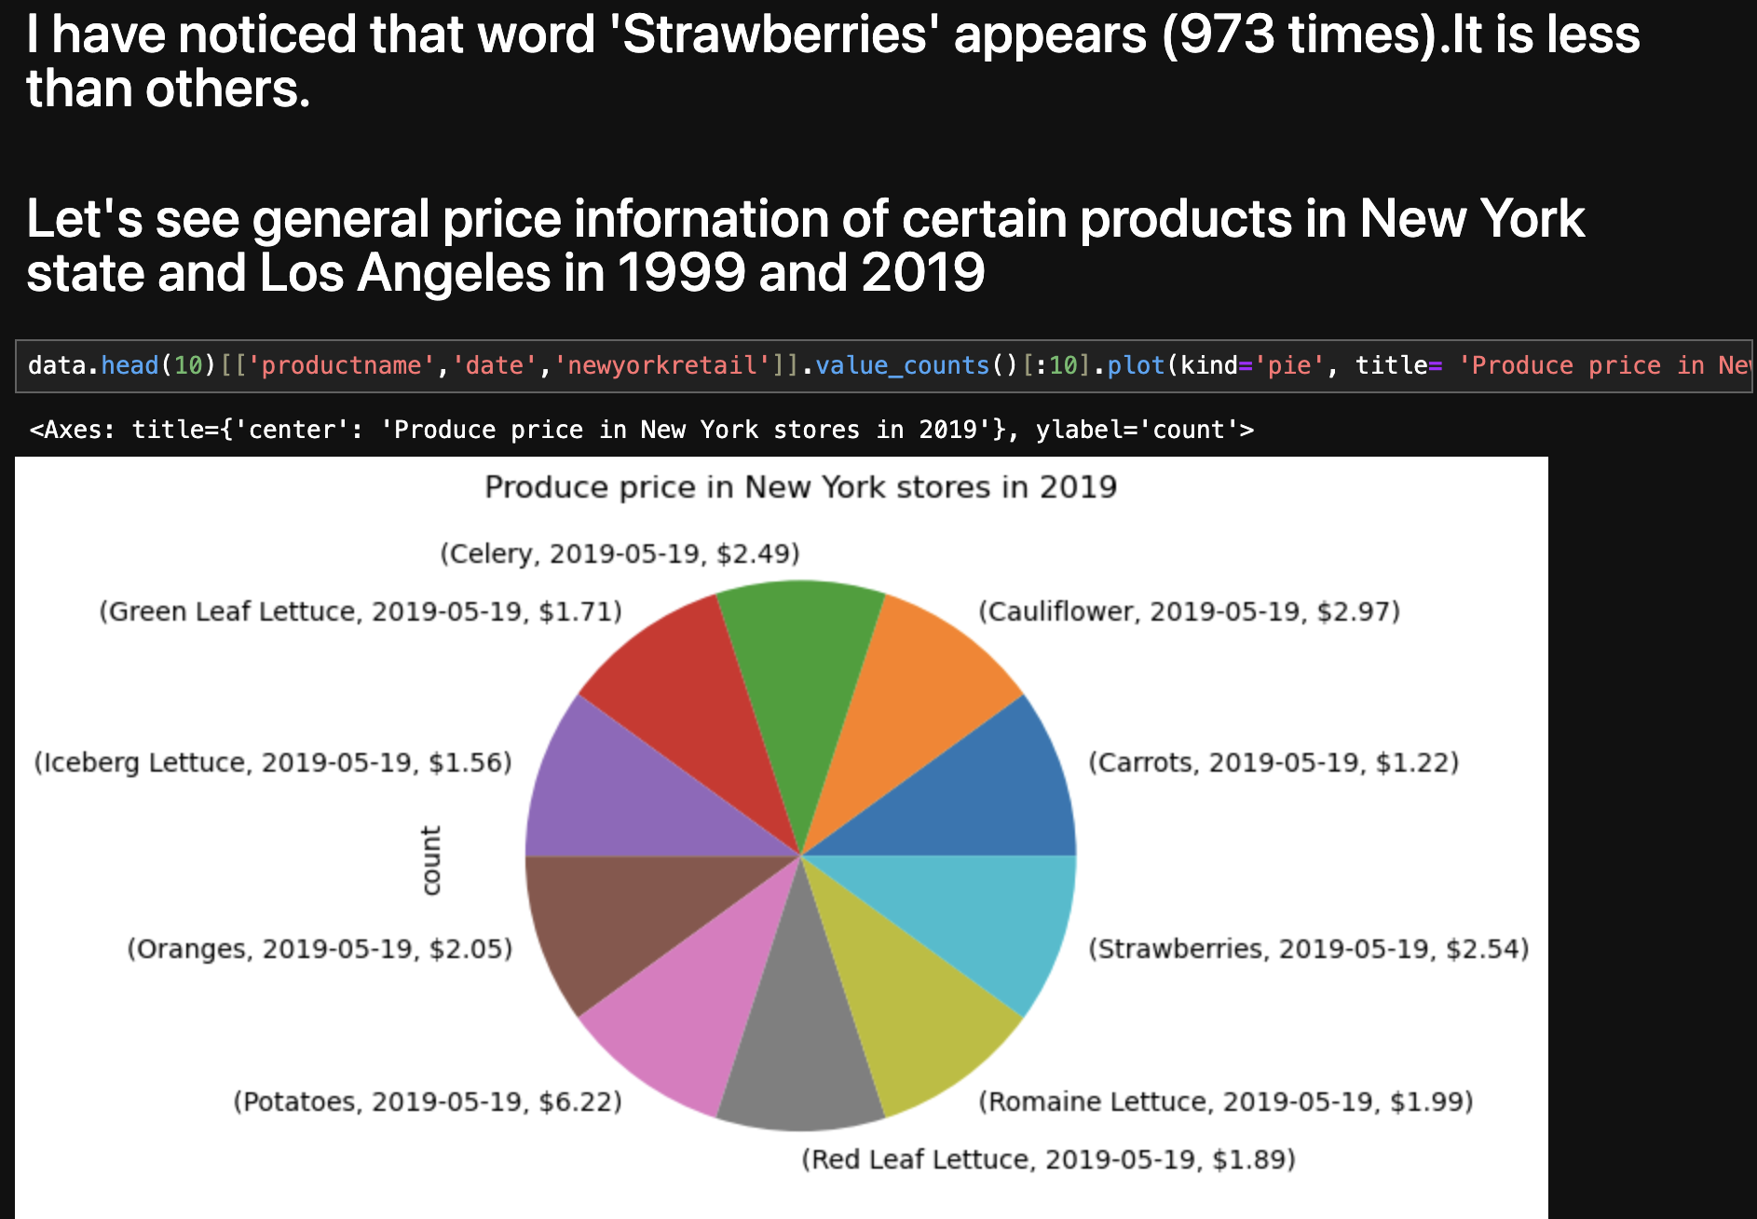

Slide 17
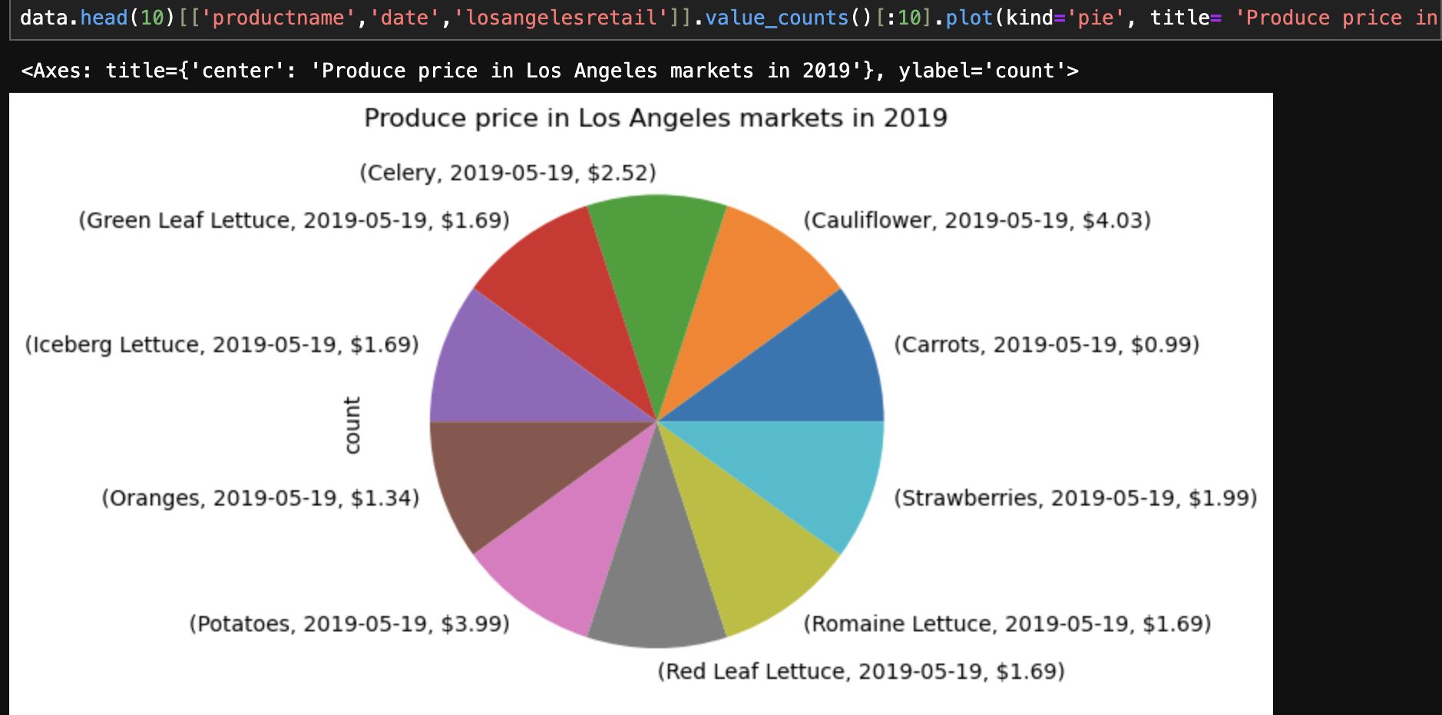

Slide 18
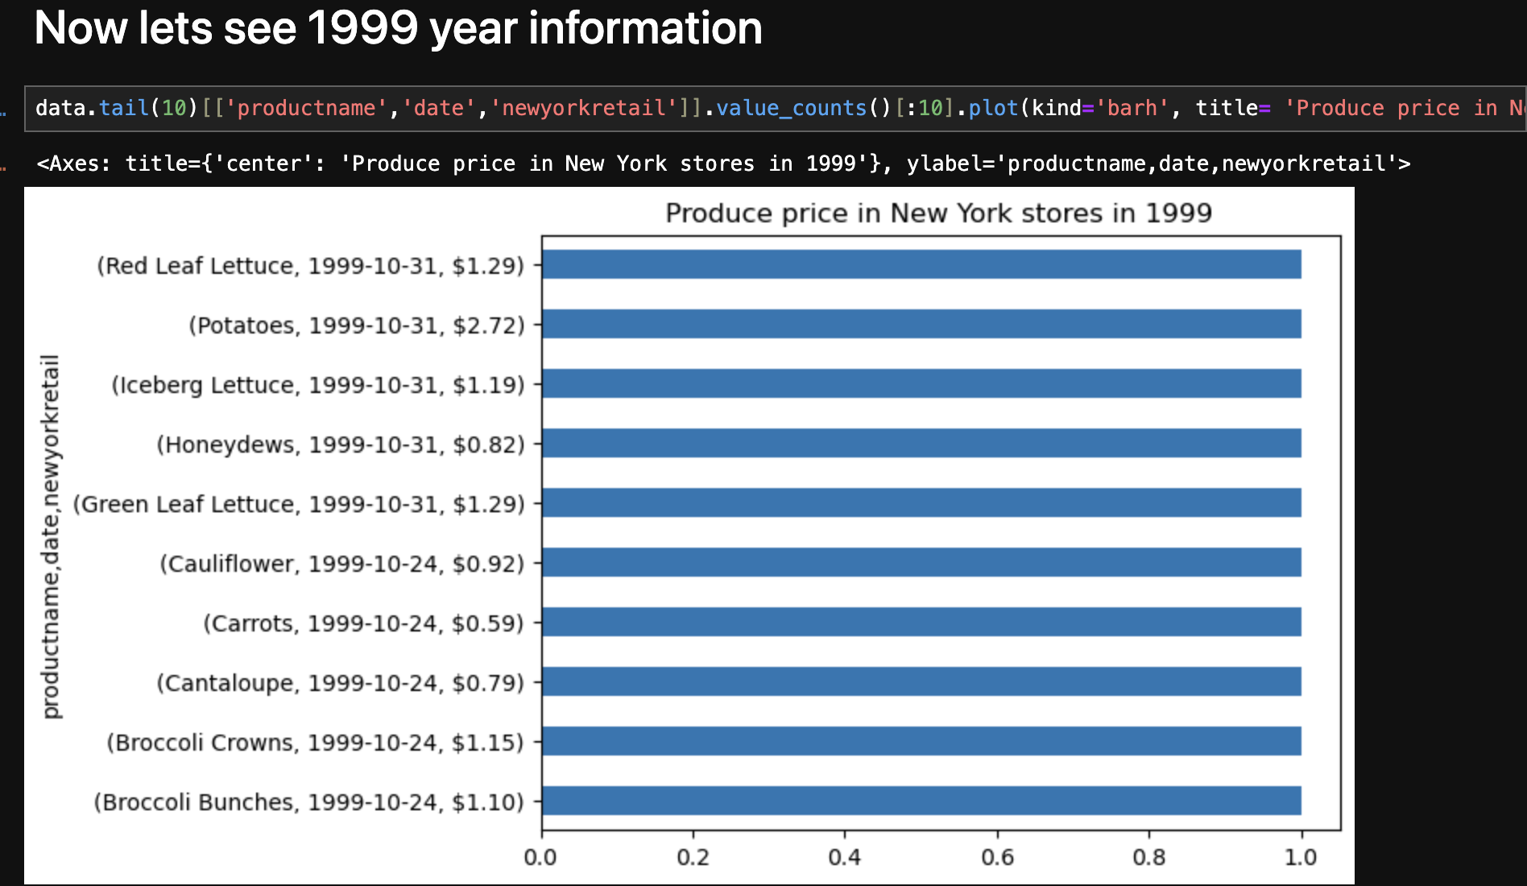

Slide 19
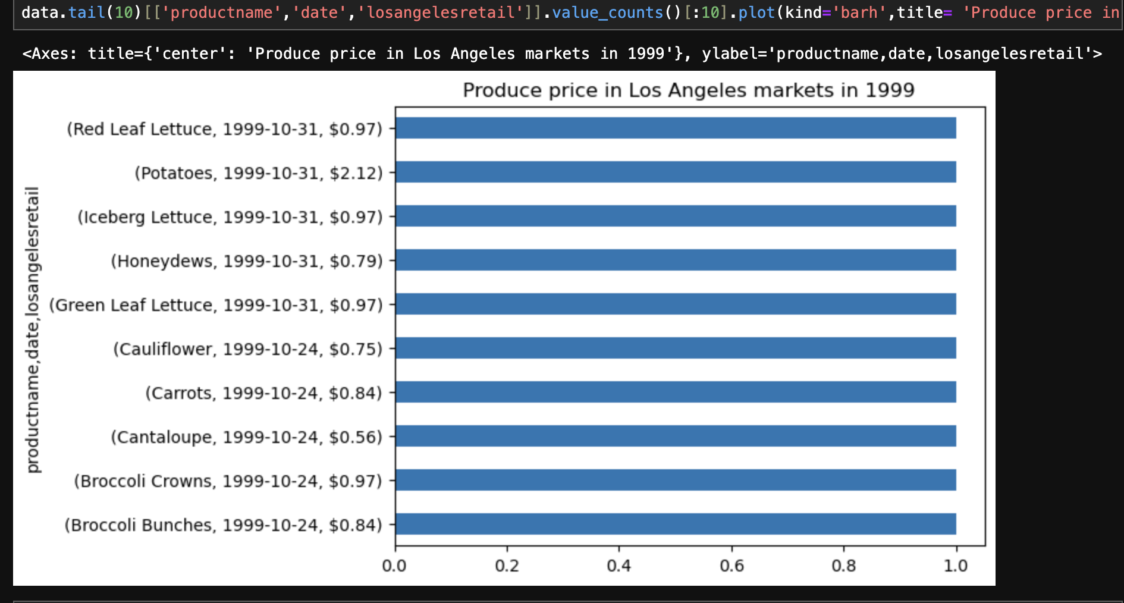

Slide 20
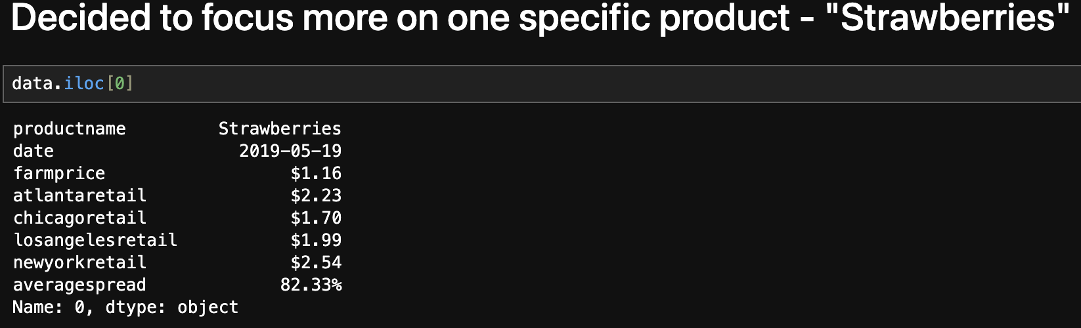
To be more accurate in my data research i need to focus on something specific

Slide 21
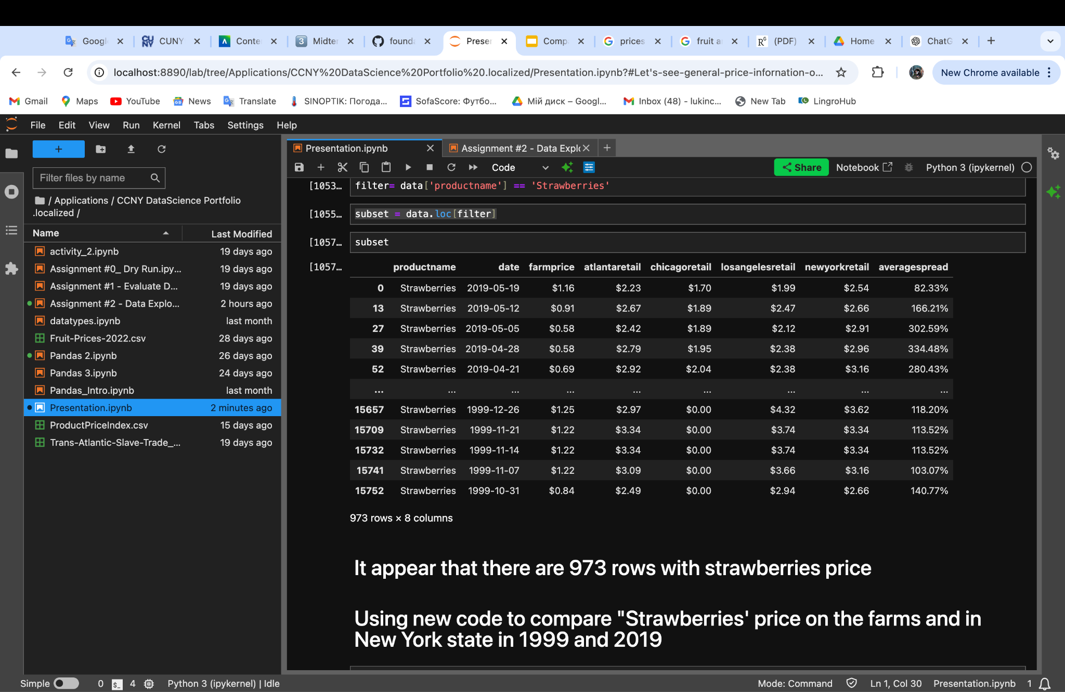
Sorting out my data

Slide 22
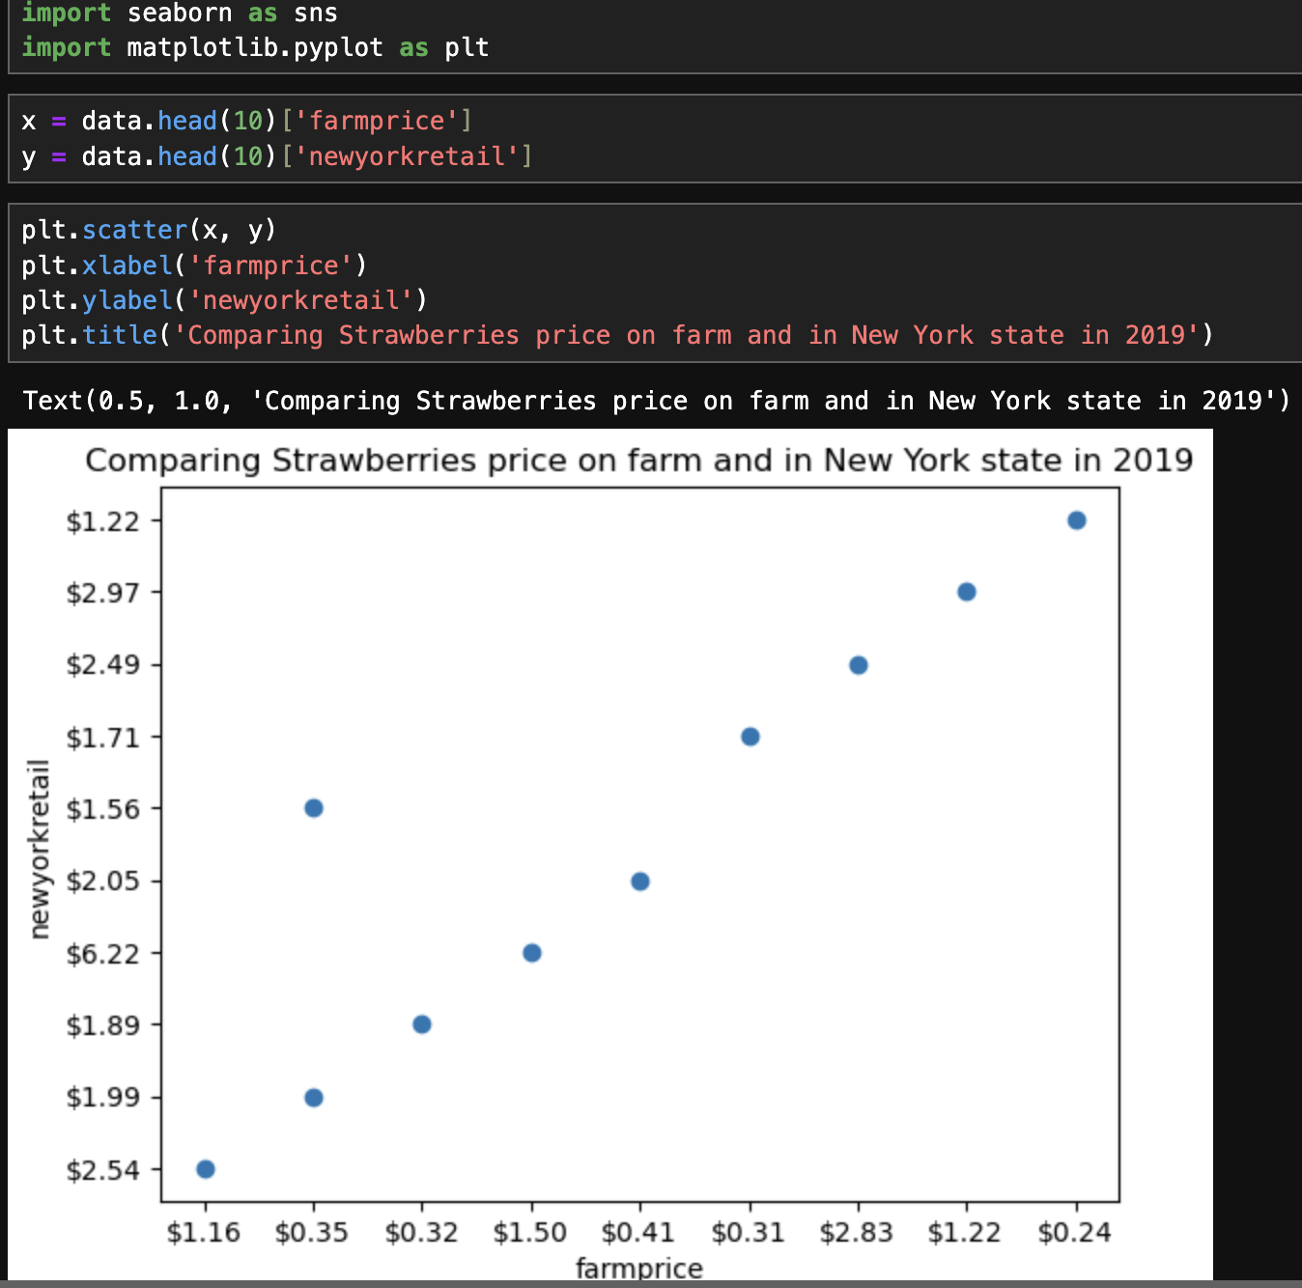
Final steps
Using a new code i am comparing price for strawberries on farms and in new york in 2019

Slide 23
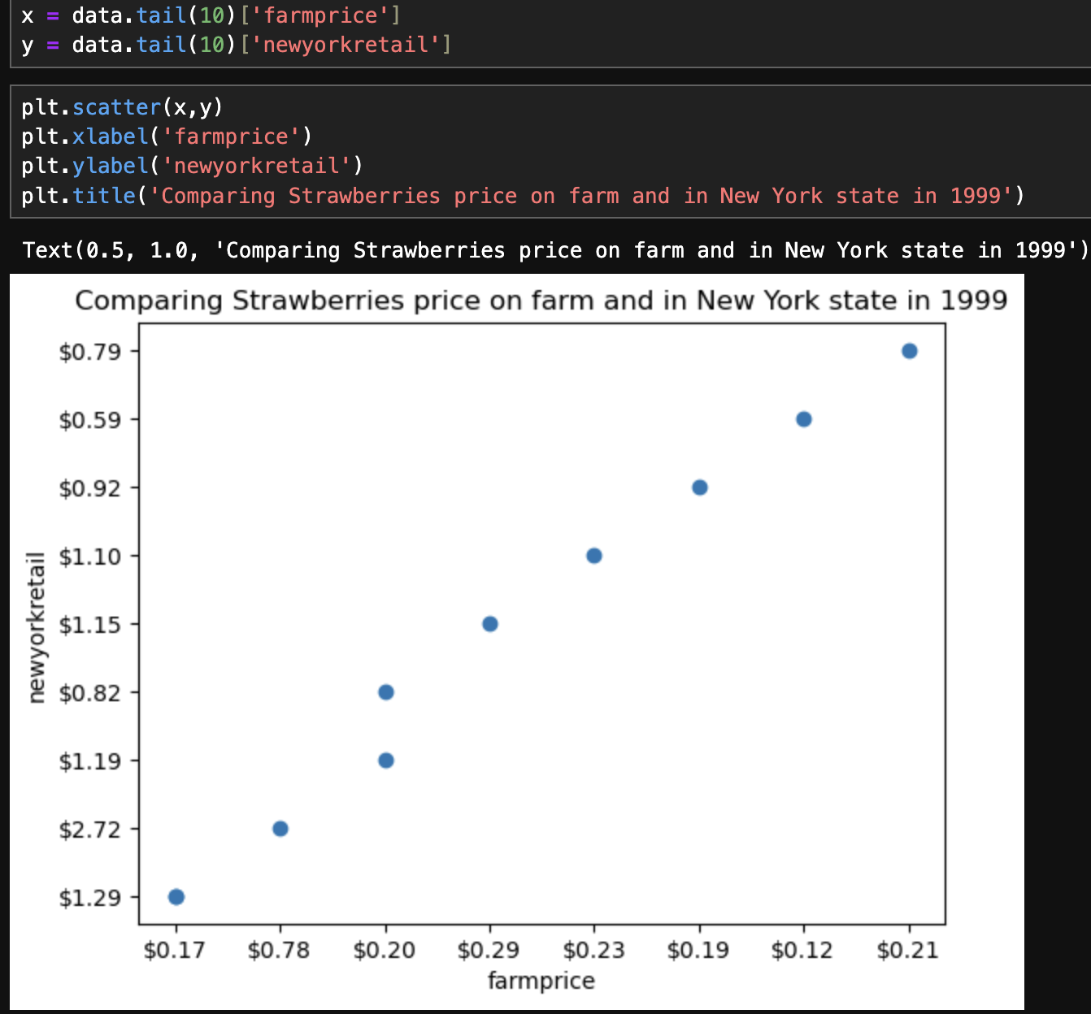
2. Comparing Strawberries’ price on farms and in New York state in 1999

Slide 24
Conclusion
The data of products’ price in USA was compared(1999-2023)
From all of information i focus on a specific product “Strawberries” to be more precise in my research.
On my own, i decided to check how the price changed between 1999 and 2023.
The difference was really noticeable and there could be a few factors of this changes in price.
As for the main is inflation which put higher prices for labor, transportation, storage and market.
Other reasons could be: environmental changes.
This research gave me useful experience in collecting, extracting, researching and exploring dataset.

Slide 25
References
1.https://localfarmmarkets.org/cost_of_fruits.php
2.https://www.researchgate.net/publication/23516854_How_Much_Do_Americans_Pay_for_Fruits_and_Vegetables
3.https://www.thepacker.com/news/education/2022-fresh-trends-report-reveals-top-20-fruit-and-vegetables
4.https://www.iowafarmbureau.com/Article/Update-on-fruit-and-vegetable-prices-January-24-2023

